Slide 1
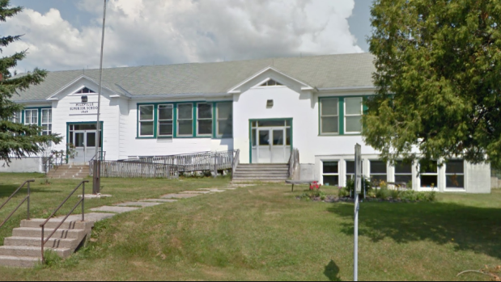
Save Our School
We’re worth it!

Slide 2
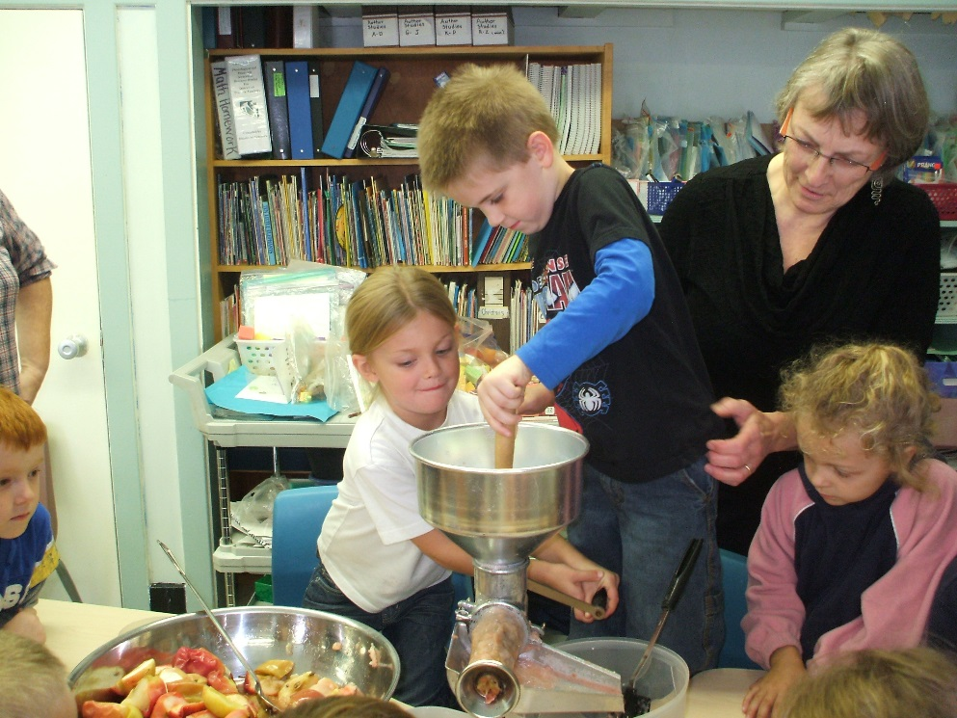
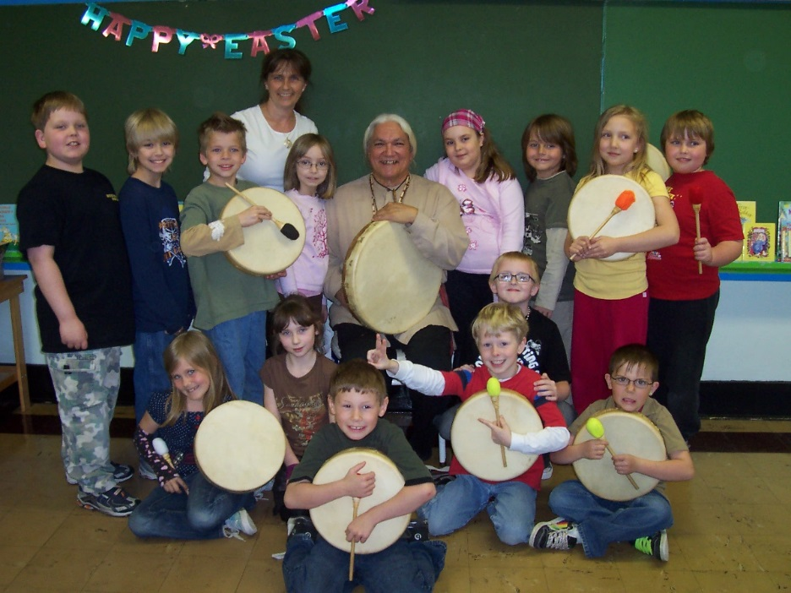
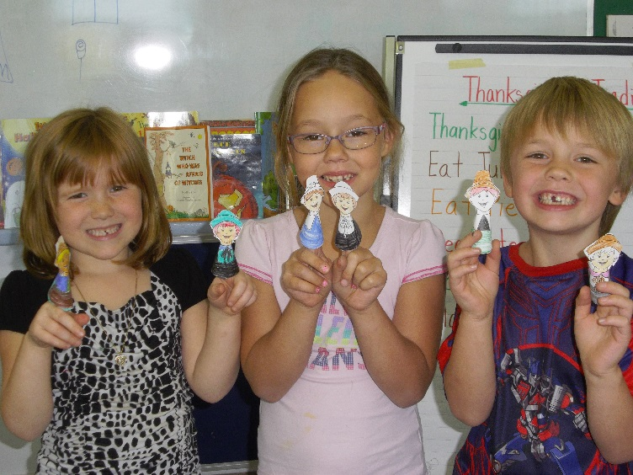
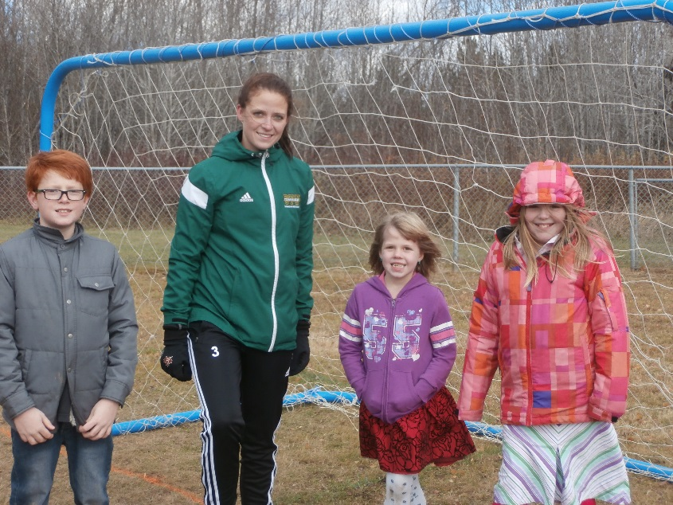
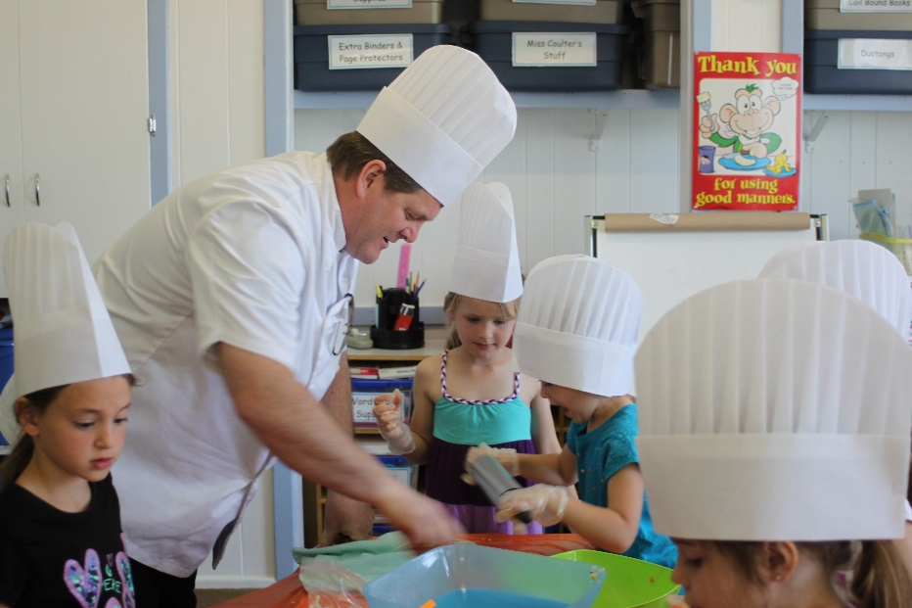
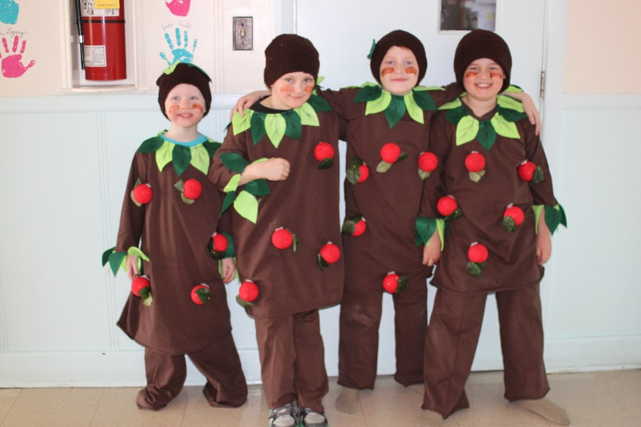

Slide 3
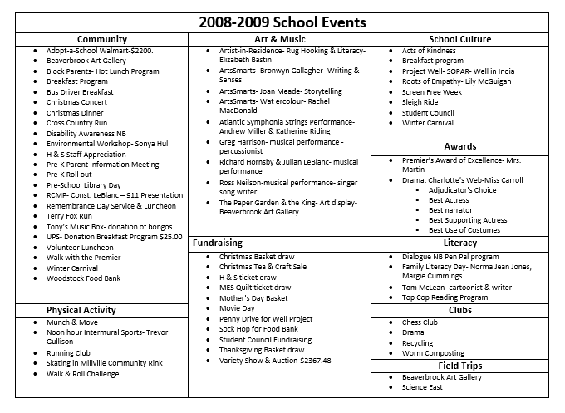

Slide 4
2014-2015 School Events
Community | Art & Music | School Culture
Bus Drivers’ Breakfast Canadian Mental Health Association- Kristie Dickinson Christmas Choral Sing a long- Harpist- Daphne Mc Carthy Christmas Concert Crabbe Mountain Dairy Farmers of Canada Dental Hygienist- Jasmine Ferguson Disability Awareness- Walk and Roll Challenge Fredericton Arts Alliance Hawkins Corner Ladies Aide- Donation Grade 5 Farewell International Walk to School Lunch Box Social Millville Fire Department -Justin Mc Guigan guest Natalie Paget- Photographer Natalie Paget- Photographer NB Children’s Foundation- donation $5000 NB Choral Federation Workshops - Dianne Roxborough-Brown with Jennifer Vail & Shawn Patrick Henry on vocals Pre-K events Remembrance Day Service & Luncheon Royal Canadian Legion- donation for Grade 5 Farwell Volunteer Luncheon Walk to Cure Diabetes Year End Family Picnic | Art for River Valley Hospital- Mike Mc Ewing workshop Artist-In-Residence- Yvonne Kershaw- Bassoonist Christmas Carol Sing along- Daphne Mc Carthy- Harpist Live Painting- Sharon Hodgson NB Choral Federation- Dianne Roxborough-Brown, Jennifer Vail, Shawn Patrick Henry Perma Culture- Calithumpians | Career Week French Culture Day- Denise Andrews International Food Revolution Day- Terry Underhill- chef Internet Safety- Angela Taylor Thumbody Program-Kristie Dickinson Wellness- Growing & tasting sprouts, green food tasting WITS Program- Jillian Chute Zones of Regulation- Jillian Chute
 | Field Trips | Literacy
 | Atlantic Super store-Woodstock Connell Park Playground & Park Mactaquac Provincial Park | Writers in Schools- Kelly Cooper Library- Apple Pie Book- making mini apple pies Time travel project- Grade 2-3
 | Clubs | Awards
 | Drama Club- Wizard of OZ | Drama-Wizard of OZ Best Characterization-Summer Best use of originality-Drama Team Best Use of Voice-Munchkins
 | Fundraising | Physical Activities
 | 50-50 Draw-$100 Gift card Wreath- Millville Fire Dept. fire truck fund-$167.00 raised Terry Fox Marathon- Walk to Cure Diabetes-$202.02 raised | Cross Country Meet Dairy Farmers of Canada-Multi-zone- Renee LeBlanc Phys. Ed. Gymnastic Workshops & noon hour clubs- Joe Crossland Premier’s Challenge Recess Phys. Ed. Student Led clubs Square Dancing workshops- Eugene & Sharon Dickinson Winter carnival events

Slide 5
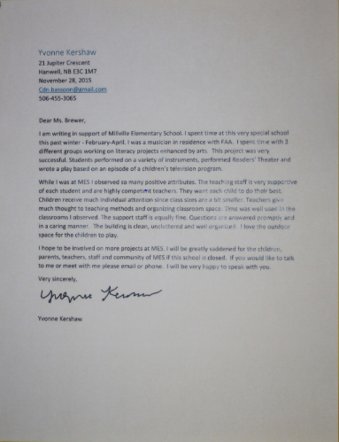
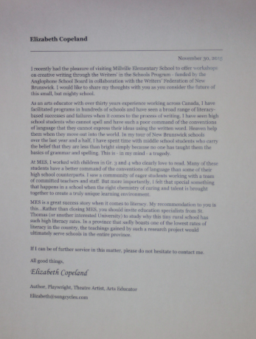

Slide 6
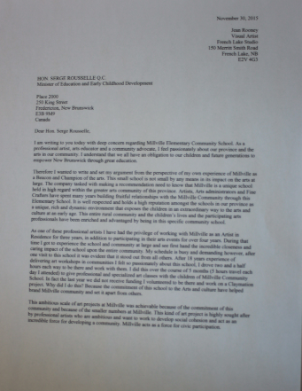
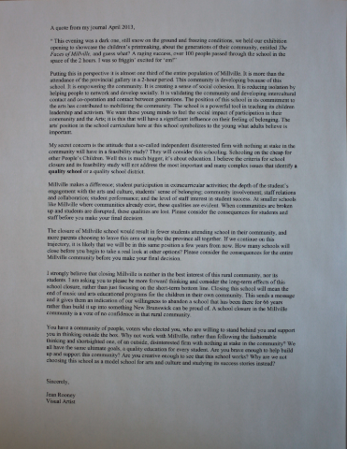

Slide 9
Millville Elementary
Nackawic Elementary
Grade 2 and Grade 4 Reading Results

Slide 10
Grade 5 Numeracy Results

Slide 11
Initial Benefits of Small Class Sizes
taught in a ‘family like’ environments reduces effects of not attending preschool improved attendance score substantially better on reading and mathematics tests higher levels of engagement participate more in school less time is spent on classroom management increased instruction time | receive more individualized instruction more one-on-one and small group help more lessons are taught through ‘hands-on’ activities more positive teacher and student interactions teachers are more engaged with their students teachers ‘burn out’ less often

Slide 12
Long term Benefits of Small Class Sizes
almost a full year ahead of their peers by 8th grade lower teenage pregnancy rates less juvenile criminal behavior more likely to graduate more likely to enroll in college increased savings in health care live on average 2 to 5 years longer

Slide 13
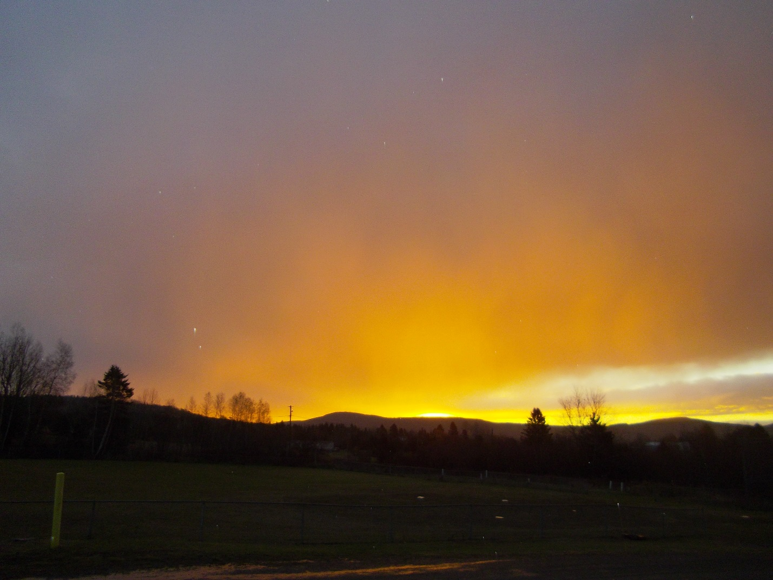
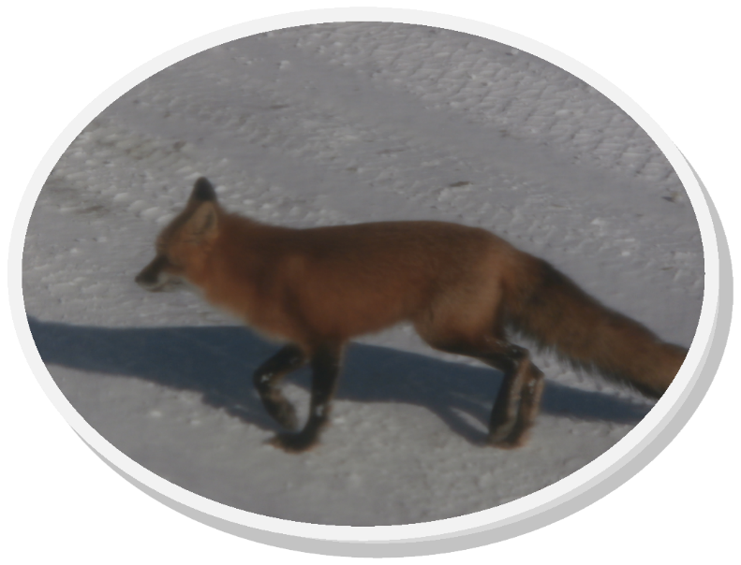

Slide 14
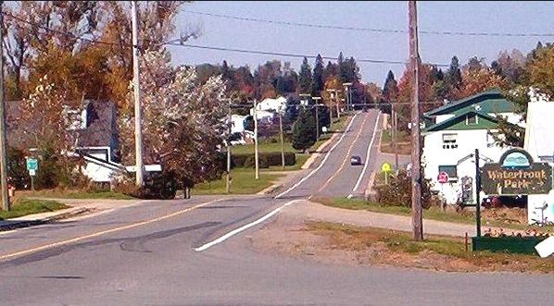
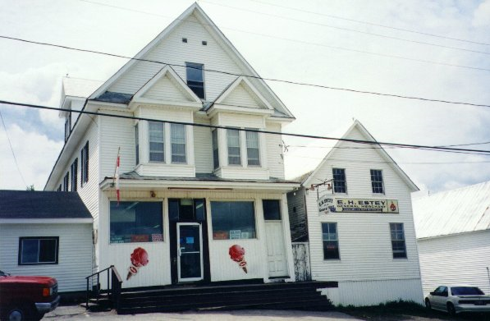
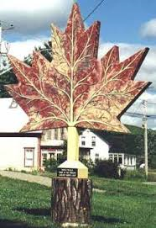
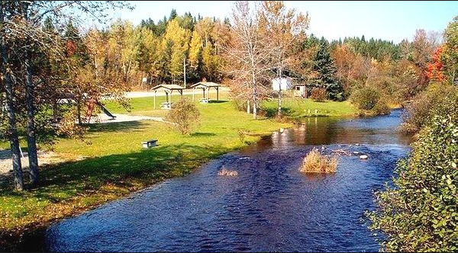
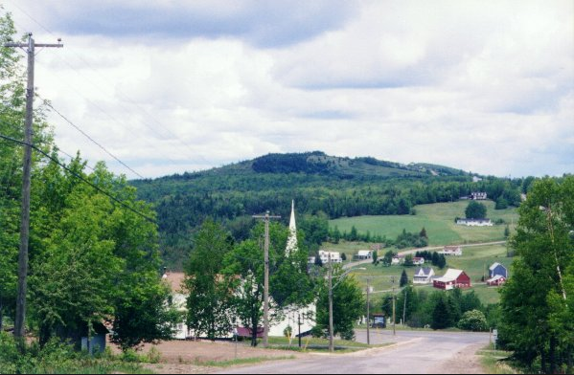

Slide 15
Students Who Feel Connected at School Are:
More likely to attend school regularly Stay in school longer Have higher grades and test scores Less likely to smoke cigarettes or drink alcohol Less likely to have sexual intercourse Less likely to carry weapons or become involved in violence Less likely to be injured from dangerous activities such as drinking and driving or not wearing a seatbelt Less likely to have emotional problems, suffer from eating disorders or experience suicidal thoughts or attempts

Slide 16
Consequences of Children Not Being Connected to Their School
Lose sense of pride and identify for their community Are less engaged in what is happening Fail to learn about the history, values and experiences of their own people Are less engaged in what is happening in their communities Lose their connections to the older citizens

Slide 19
2015 Capital Improvement Projects Recommended
Priority 1 | Priority 2 | Priority 3
Intercom system | Wheelchair lift and automatic door openers Roof reshingling Window replacement Backflow prevention Electrical upgrade (panels) Ventilation system and electrical upgrade | Office relocation Floor replacements Siding replacement Paving

Slide 21
New Brunswick Buses Vs. NB Student Enrolment
 | Amount of Buses | Amount of Students
2009 | 1,156 | 85,000
2014 | 1,237 | 74,055
Difference | 81 additional buses | 10,945 less students

Slide 22
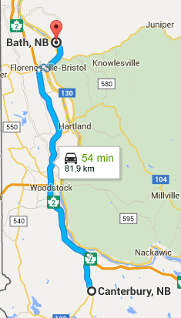
Canterbury to Bath (50 minutes)

Slide 23
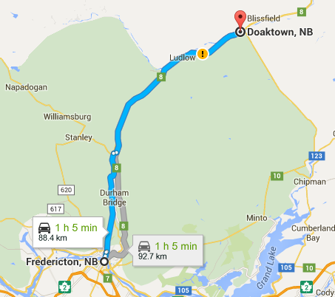
Fredericton to Doaktown (65 minutes)

Slide 24
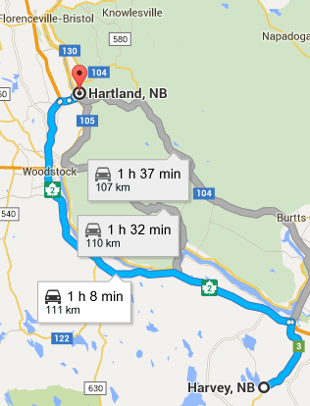
Harvey to Hartland (67 minutes)

Slide 25
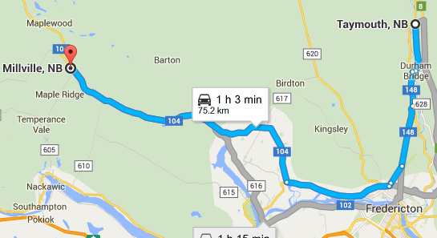
Taymouth to Millville (63 minutes)

Slide 26
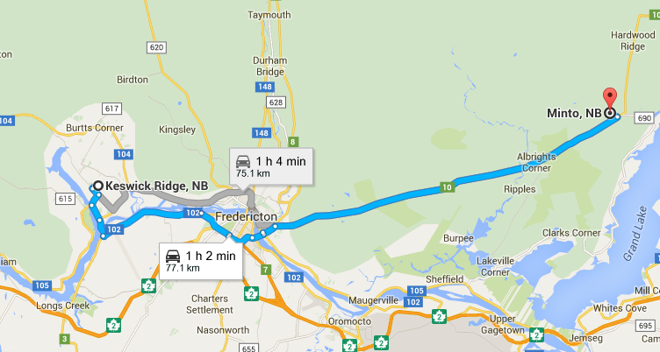
Keswick to Minto (67 minutes)

Slide 27
Busing- Time Adds Up
1 day | 2 hours 10 minutes
1 week | 10 hours 50 minutes
1 year | 401 hours 23 minutes
K-5 | 2405 hours 39 minutes

Slide 28
Time Spent from Kindergarten to Grade 5
2405 hours = 100.2 24 hour days
2405 hours= 200.4 12 hour days
200.4 days= over half a year (54.9%)

Slide 29
What Matters?
A vote to close Millville Elementary School says that:
Quality of education
Impact on the community
Academic achievement of students
Over 400 hours a year on a bus
What’s right for children
Does Not Matter

Slide 30
What Matters Most?
$

